Slide 1
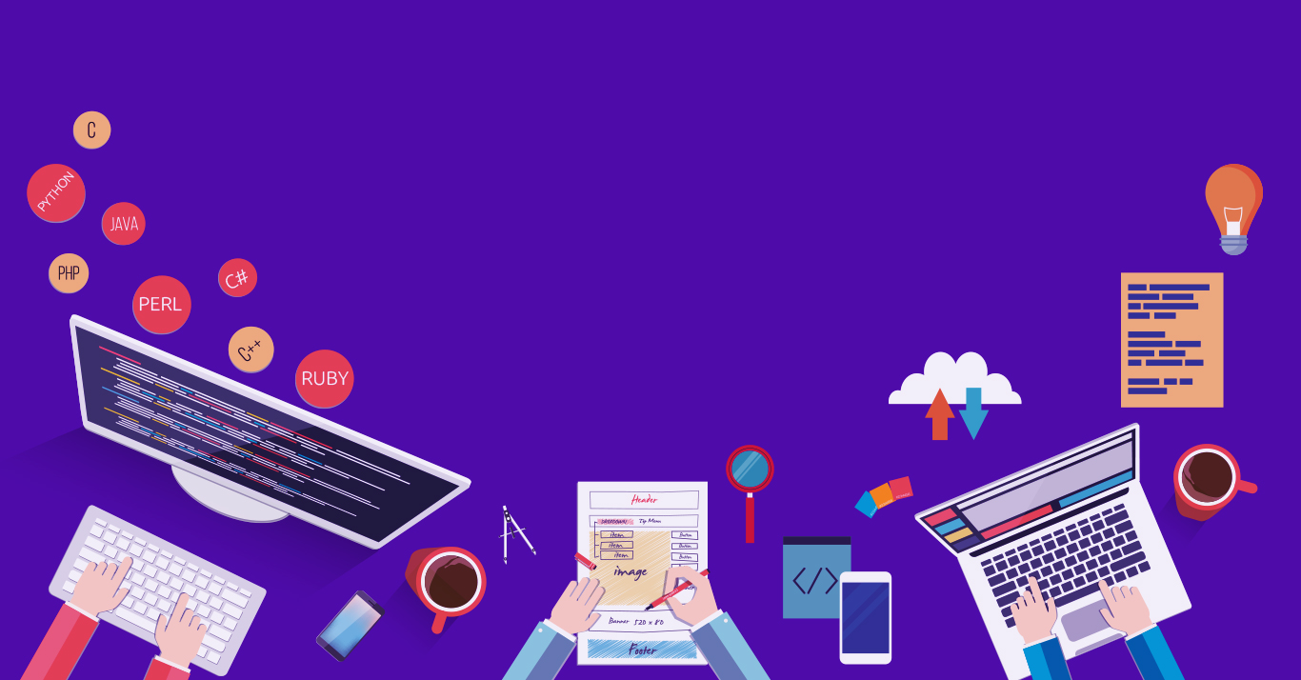

Introduction to
Robotic Process Automation
Title of the Project
Your Register No.220701259
Name V SHAKTHI PRIYA
Guide Name DR.N. DURAIMURUGAN,M.E,ph.D

Slide 2
Abstract
The "Fitness Guide Chat Bot", built with UiPath, automates personalized fitness guidance by collecting user inputs such as height, weight, and fitness goals (weight loss or gain) through dialog activities. Leveraging AI-powered content generation, it creates tailored diet and exercise plans, which are then converted into user-friendly formats and sent to the user's email using SMTP. By integrating tools like email automation, data handling, and AI-driven recommendations, this bot streamlines fitness planning, reduces manual effort, and ensures convenient and personalized health guidance for users, making it ideal for individuals aiming to achieve their fitness goals effectively.

Slide 3
Need for the Proposed System
The current fitness planning process often involves manual research and guesswork, making it time-consuming, inconsistent, and challenging for individuals to create personalized diet and exercise plans. These challenges hinder effective goal achievement and require significant effort to manage. A robust and automated solution is essential to streamline this process, ensuring accuracy, personalization, and prompt delivery of tailored fitness guidance without overwhelming the user.

Slide 4
Advantages of the Proposed System
The "Fitness Guide Chat Bot" automates the process of creating personalized fitness plans, minimizing manual effort and ensuring accuracy. It efficiently gathers user inputs, generates tailored diet and exercise plans using AI, and delivers them directly to the user's email via SMTP. This automation saves time, enhances accessibility, and provides a seamless experience for users. By offering personalized and timely guidance, the system empowers individuals to achieve their fitness goals effectively, making it an ideal solution for health-conscious users.

Slide 5
Literature Survey
Survey on Diet and Exercise Plan Personalization Using AI: AI-based techniques for generating tailored diet and exercise plans have revolutionized fitness management. Research indicates the growing relevance of machine learning and AI to deliver highly personalized recommendations for individuals.
Williams (2022) reviews AI-based data processing methods for diet personalization, showcasing their accuracy in catering to diverse user needs.
Tan and Lee (2019) delve into machine learning approaches for customizing exercise plans, highlighting their efficiency in meeting individual fitness goals.
Survey on Automated Email Integration for Health Services Using RPA: Automated email integration streamlines communication in personal health services, ensuring timely delivery of critical information. Studies demonstrate how RPA enhances the efficiency and reliability of this process.
Jones and Martinez (2023) analyze the use of RPA in automating email notifications for personalized health services, illustrating its role in improving user engagement and service delivery.
Murphy and Ladd (2021) identify challenges in developing automated bots for health and diet services, emphasizing the importance of robust integration for seamless user experiences.

Slide 6
Main Objective
The primary objective of the "Fitness Guide Chat Bot" is to automate the generation and communication of personalized fitness plans using Robotic Process Automation (RPA). The bot efficiently collects user inputs, including height, weight, and fitness goals (e.g., weight loss or gain), and utilizes AI to create tailored diet and exercise plans. This process includes generating a fitness chart, converting it into a PDF, and sending it via email to the user. The project aims to streamline fitness management and provide users with customized health solutions, ensuring accessibility, efficiency, and motivation toward achieving their fitness goals.

Slide 7
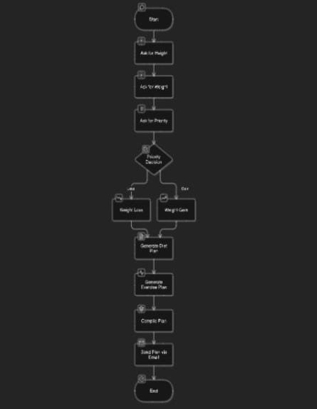
Architecture Diagram

Slide 8
System Requirements
Hardware Requirements
Computer/Laptop:
Processor: Intel i3 or above / AMD Ryzen equivalent
RAM: 8 GB or more
Storage: At least 256 GB (SSD recommended for faster performance)
Operating System: Windows 10 or above
Software Requirements
Development Tools:
UiPath Studio: For building and running the automation workflows.
APIs and External Services:
ChatGPT API: For generating diet and exercise plans.
SMTP Server: For sending personalized emails (e.g., Gmail, Outlook).

Slide 9
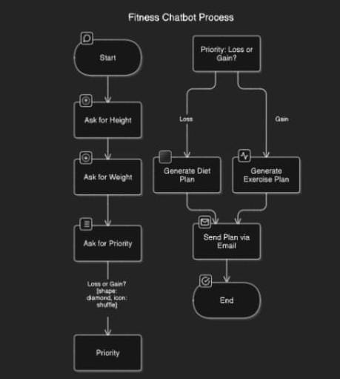
Functional description-flow diagram

Slide 10
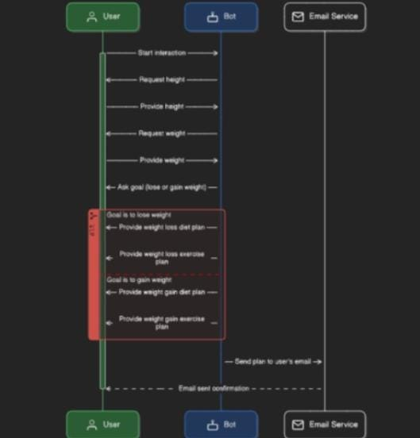
Functional Description-sequence diagram

Slide 11
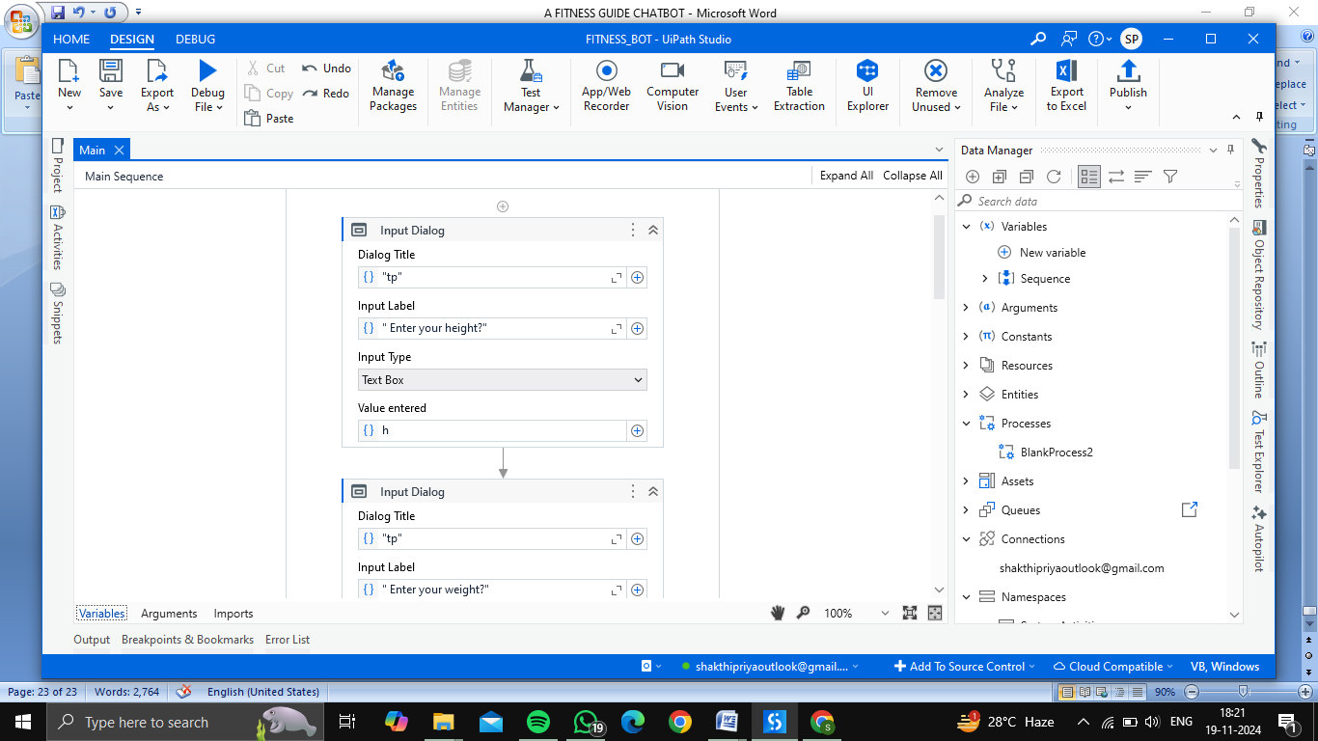
Process Design

Slide 12

Process Design

Slide 13
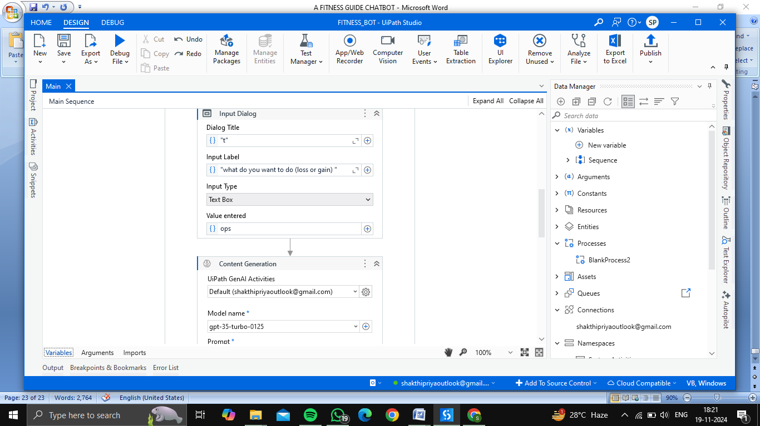
Process Design

Slide 14
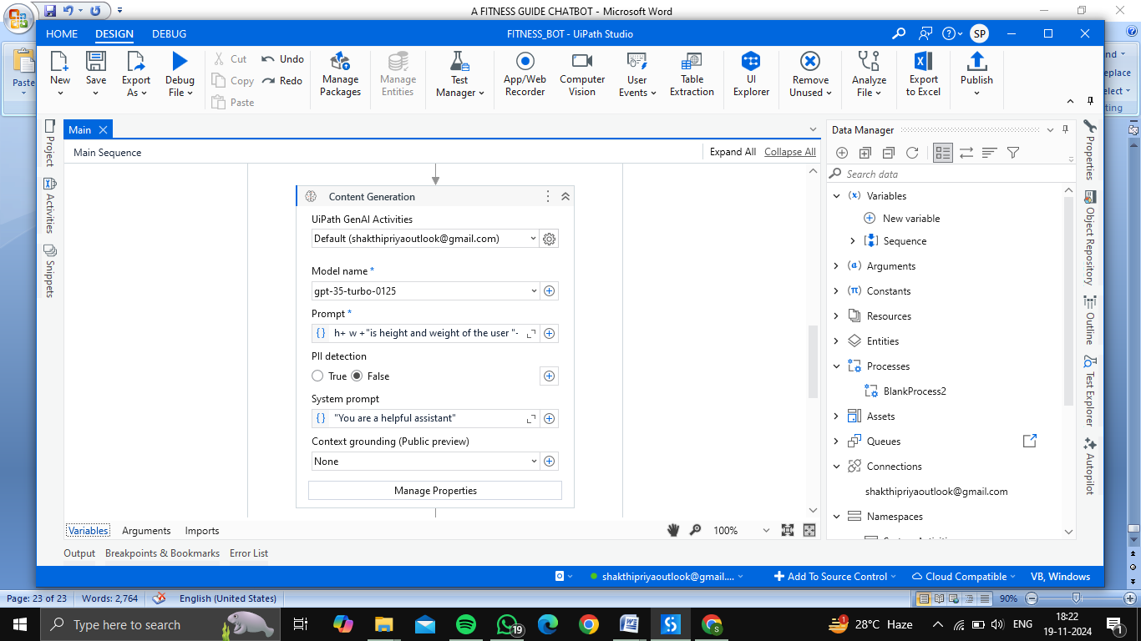
Process Design

Slide 15
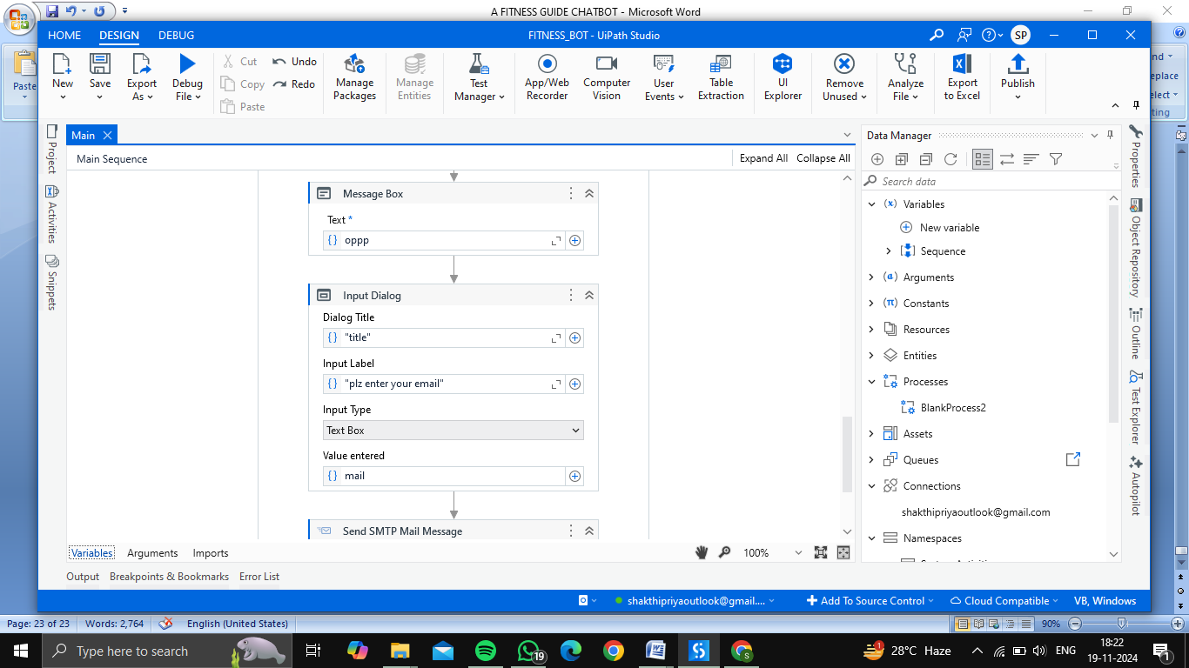
Process Design

Slide 16

Process Design

Slide 17
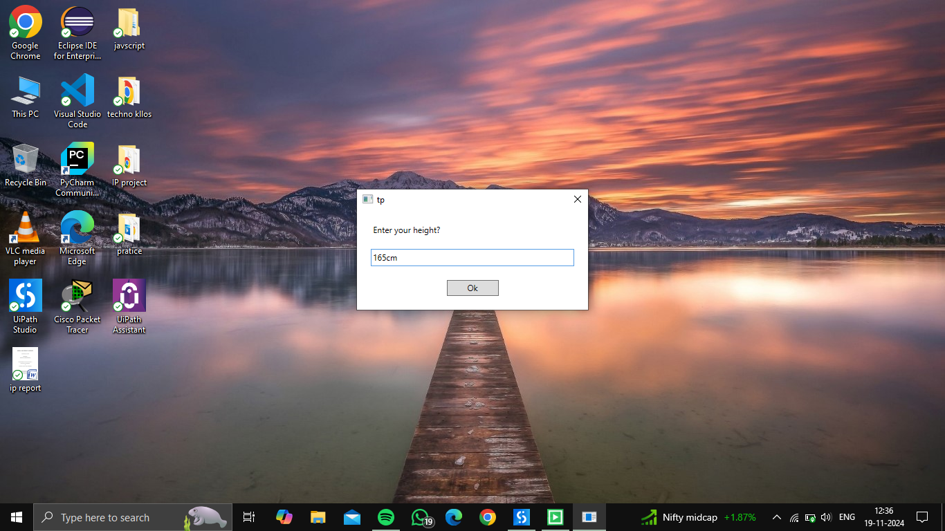
Implementation
The bot prompts the user to enter their height, forming the first step in gathering personal data for creating a customized fitness plan.

Slide 18

Implementation
The user is prompted to input their current weight, which helps the bot in calculating and tailoring the diet and exercise plan.

Slide 19

Implementation
The bot asks the user to select their fitness goal, such as weight loss, to personalize the upcoming fitness recommendations.

Slide 20
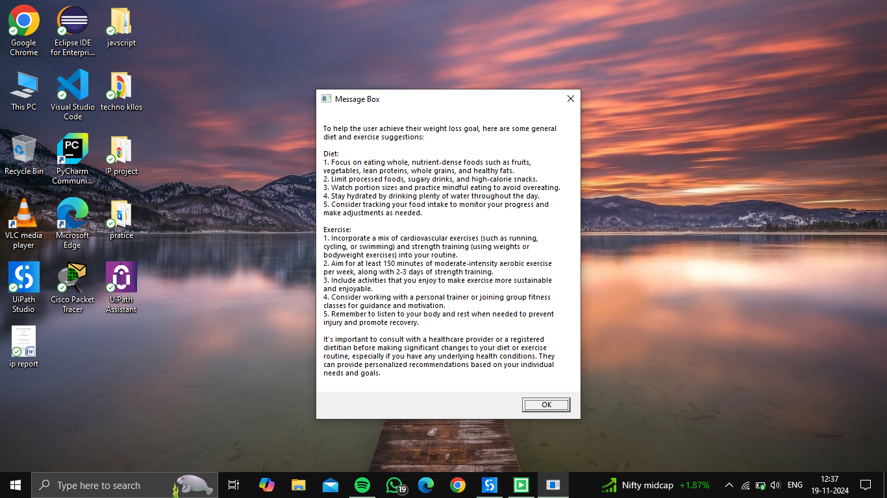
Implementation
The bot generates a detailed diet and exercise plan specifically designed for weight loss, as per the user’s input data

Slide 21
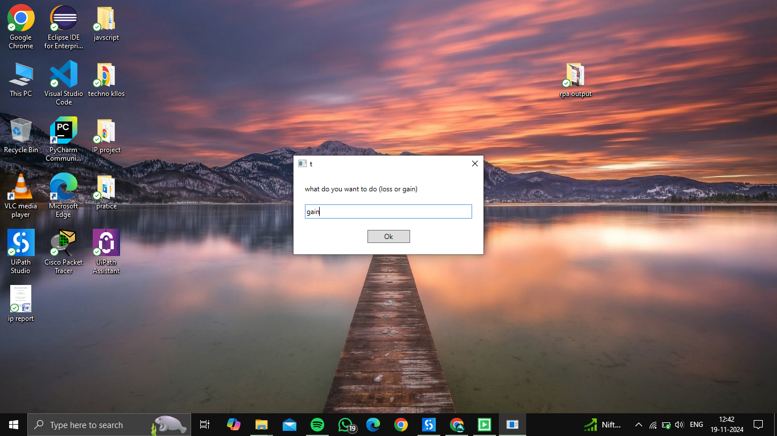
Implementation
The bot displays the user’s selection of a weight gain goal, initiating the generation of a plan suitable for their target.

Slide 22
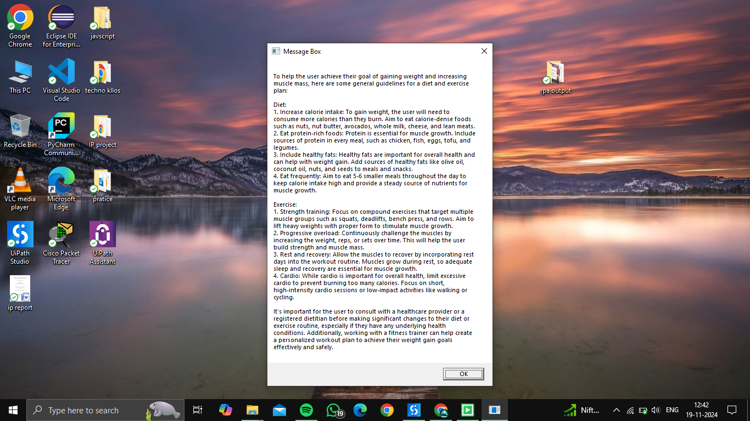
Implementation
A customized diet and exercise chart is created by the bot to support the user's goal of weight gain.

Slide 23
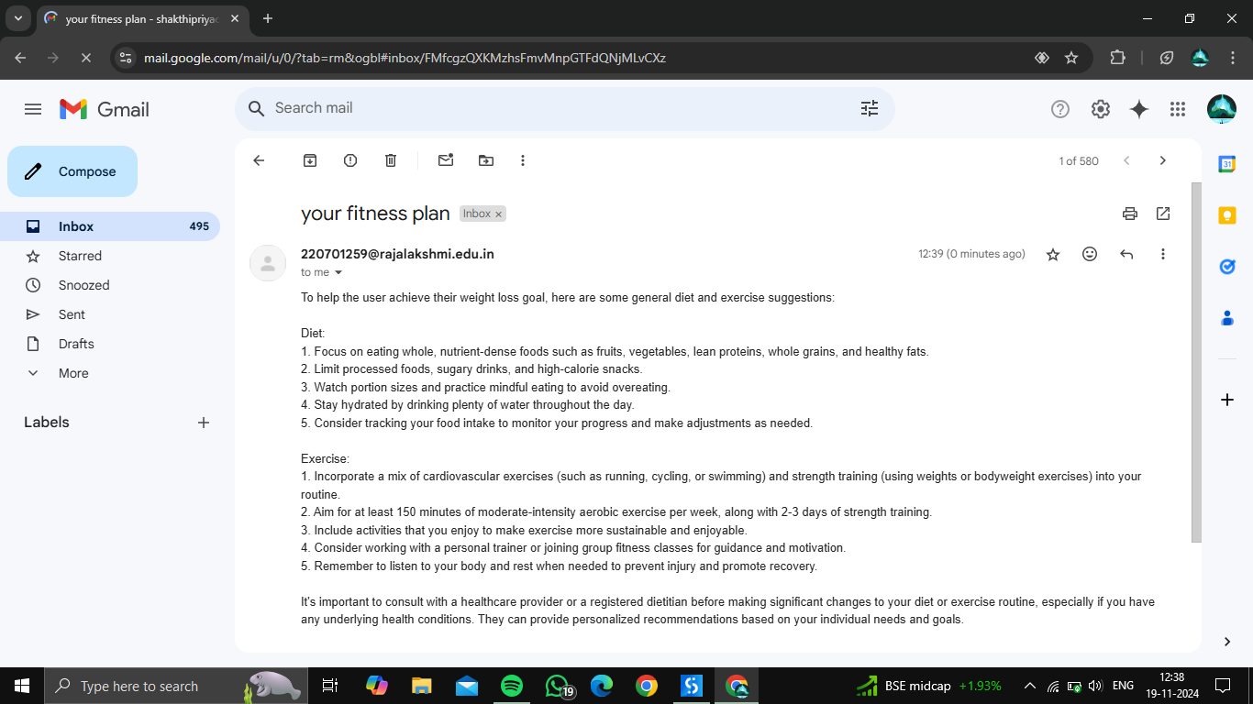
Testing
The personalized weight loss plan is sent to the user’s email, providing an accessible and easy-to-follow diet and exercise routine

Slide 24
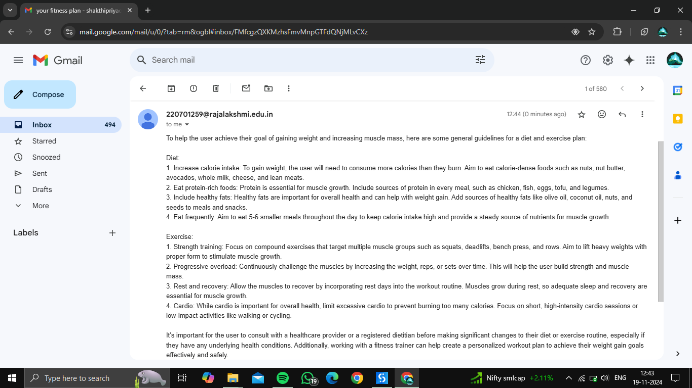
Testing
The tailored weight gain plan is sent to the user’s email, ensuring they have a clear and personalized guide to follow.

Slide 25
Conclusions
The Fitness Guide Chat Bot" marks a significant step forward in personal wellness management by harnessing the capabilities of UiPath's Robotic Process Automation (RPA). This innovative solution simplifies the process of creating personalized diet and exercise plans, ensuring that users receive accurate and tailored fitness guidance efficiently. The project’s ability to provide real-time updates and deliver customized plans via email enhances user engagement, presenting a streamlined and user-friendly experience. By automating the collection of user data and content generation, the bot allows users to access expert wellness advice without manual effort, empowering them to pursue their fitness goals effectively. While the system offers comprehensive and data-driven fitness plans, its scope may be limited by the need for human intervention in cases requiring nuanced dietary or fitness recommendations. Regular updates to the AI algorithms and exercise databases will be essential to keep up with advancements in health and nutrition knowledge.

Slide 26
Future Enhancement
Looking ahead, several enhancements can be introduced to further improve the "Fitness Guide Chat Bot." Adding error-handling mechanisms will ensure seamless functionality, addressing invalid or incomplete user inputs effectively. Integration with fitness tracking devices or apps could provide real-time monitoring of user progress, enhancing the bot's personalized recommendations. Additionally, incorporating multilingual support would make the bot accessible to a broader user base. Future updates may also include advanced AI-driven insights, such as tracking caloric intake through meal photos or generating dynamic exercise plans based on user feedback. These enhancements would significantly elevate the bot's utility, making it a comprehensive and adaptive tool for personalized fitness management.

Slide 27
References
[1] Singh, R., & Sharma, A. (2021). Robotic Process Automation in Personal Health Management: Opportunities and Challenges. Journal of Health Informatics Research, 13(2), 150-162. doi: 10.1007/s40313-021-00213-4.
[2] Patel, M., & Gupta, L. (2020). Integrating RPA in Personal Fitness Tracking Systems. International Journal of Innovative Health Technologies, 9(3), 678-683. doi: 10.35940/ijih.K2390.093022.
[3] Williams, K. (2022). Diet Personalization Using AI-Based Data Processing. Journal of Nutritional AI Studies, 7(1), 102-110. doi: 10.1029/nas.2022.10402.
[4] Jones, D. & Martinez, P. (2023). Automated Email Integration for Personalized Health Services Using RPA. Journal of Automated Systems and Healthcare, 15(4), 278-284. doi: 10.1109/JASH2023.1094392.
[5] Tan, H., & Lee, S. (2019). Machine Learning and AI Approaches for Tailoring Exercise Plans. Advances in Computational Health Engineering, 5(6), 423-431. doi: 10.1145/3410178.

Slide 28
Thank You

